Slide 1

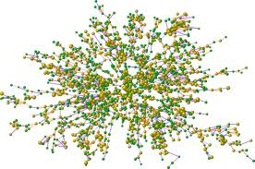
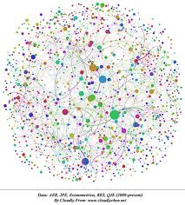



CS is a growing field entering its golden age:
BIG DATA

Slide 2
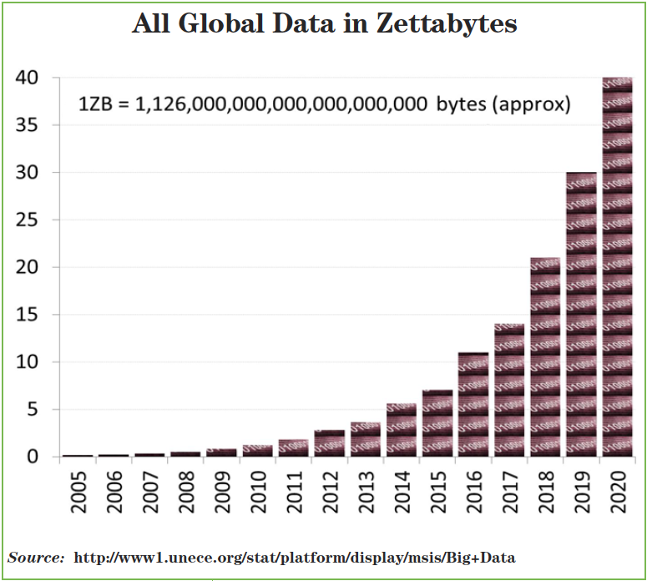
Big Data
Physical world will be increasingly driven by computers and IT
Increased importance of virtual and augmented reality world
Name (Symbol) | Value
kilobyte (kB) | 10³
megabyte (MB) | 10⁶
gigabyte (GB) | 10⁹
terabyte (TB) | 10¹²
petabyte (PB) | 10¹⁵
exabyte (EB) | 10¹⁸
zettabyte (ZB) | 10²¹
yottabyte (YB) | 10²⁴

Slide 3
Data Science and Big Data
Data science is about getting insights from big data
Steps:
collecting
processing
descriptive and predictive analytics
communicating insights to others

Slide 4
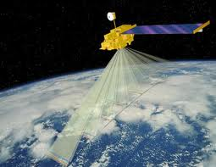
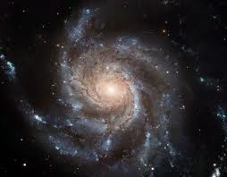


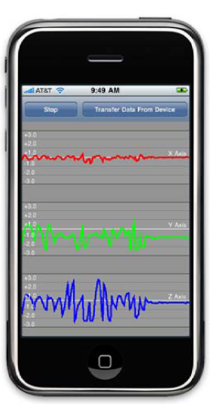
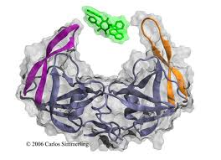
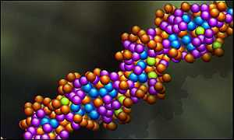
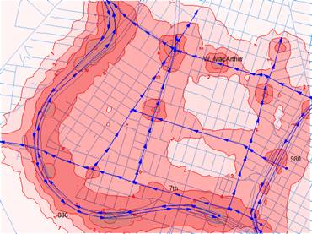
Big Data is Everywhere – Science
Remote Sensing
Astronomy
Participatory Sensing
Air, Land, Ocean
100s GBs /day
Sky surveys
120 GB/week, 6.5 TB/year
Genomics
Drug Discovery
25K genes, 3B base pairs
8B humans
thousands of organisms
2M of compounds
> 100M interactions
Notes:
Source: HubbleSite (http://hubblesite.org/reference_desk/facts_.and._figures/quick_facts/quick_facts_2.shtml#data_stats)

Slide 5
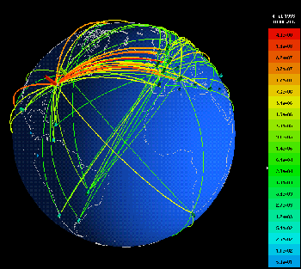



BIG DATA is Everywhere – Web
Social Networks
Internet Traffic
Web
8 Billion pages
10kB/Page
8 TB of indexed text
Typical router:
42 bytes/second
3.5 Gigabytes/day
Mobile Apps

Slide 6
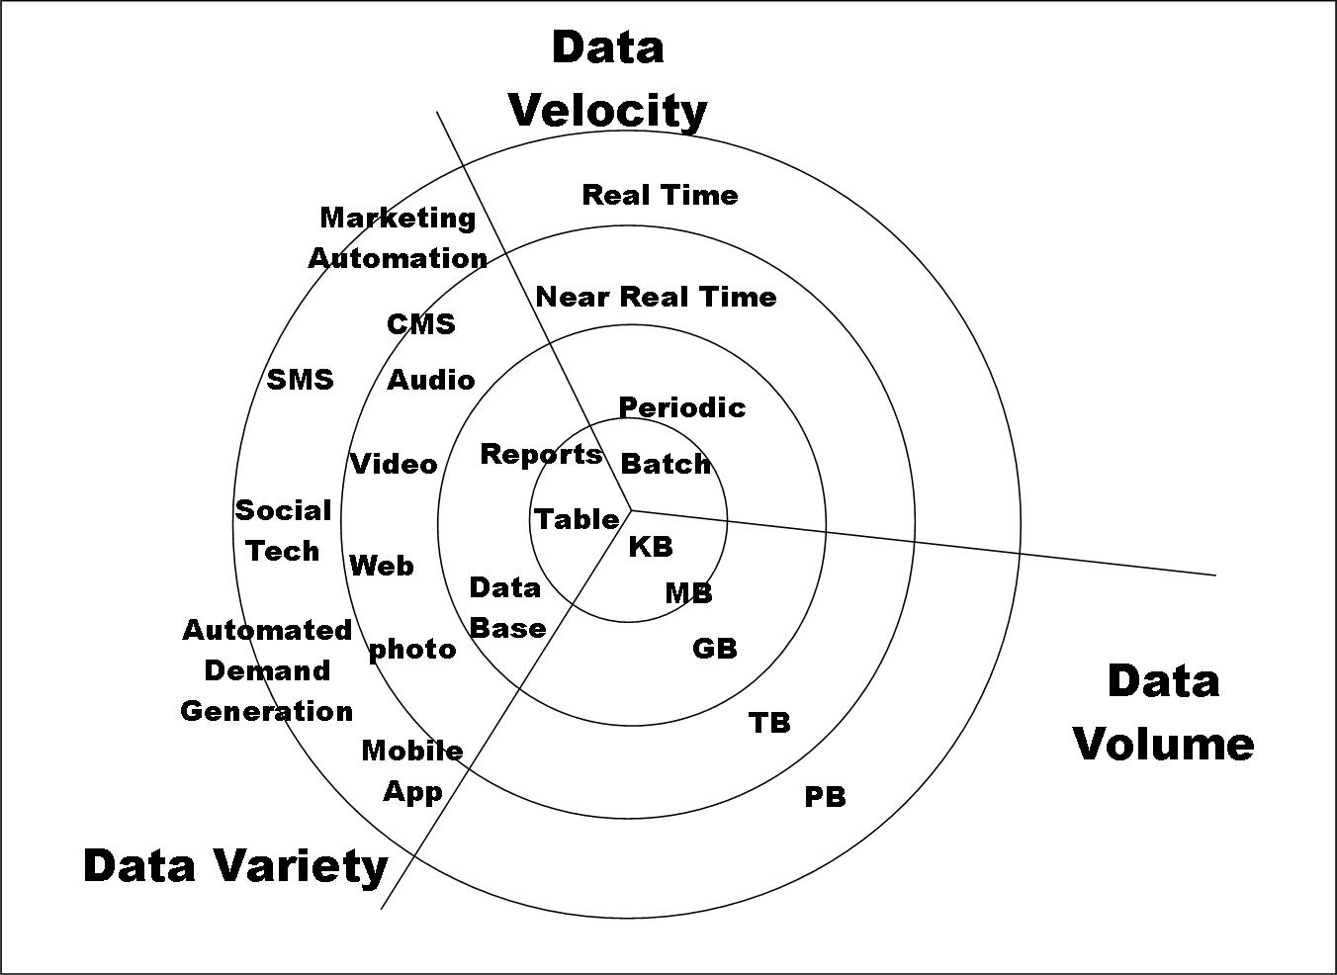

Slide 7
Big Data and Data Science Specific Challenges
Data management, collection and storage
New data storage, I/O, architectures
Efficient archiving, storing, indexing, retrieving, and recovery
Privacy and security
Languages, tools, methodologies and programming environments
Data Analytics
Data analytics under processing, memory, storage, energy constraints
Scalable and interactive data visualization
Extraction and integration of knowledge from massive, complex, multi-modal, or dynamic data
New algorithms, languages, data structures for data analytics
Notes:
Source: http://www.sims.berkeley.edu/research/projects/how-much-info/

Slide 8
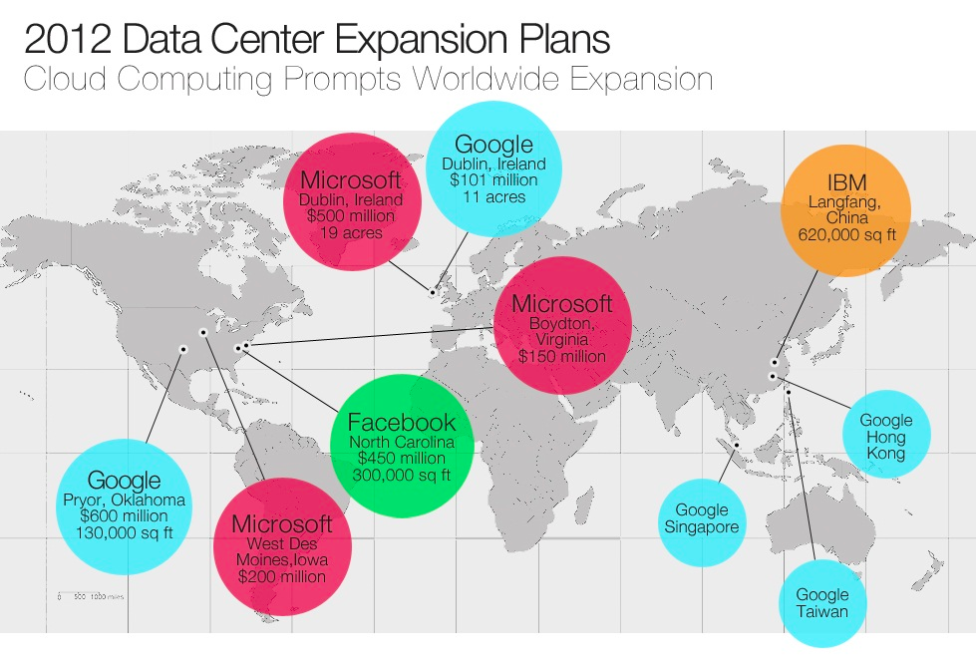
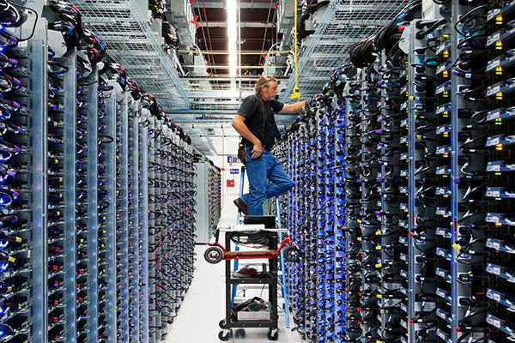
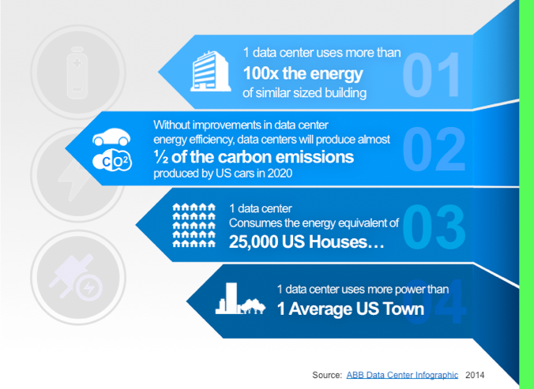
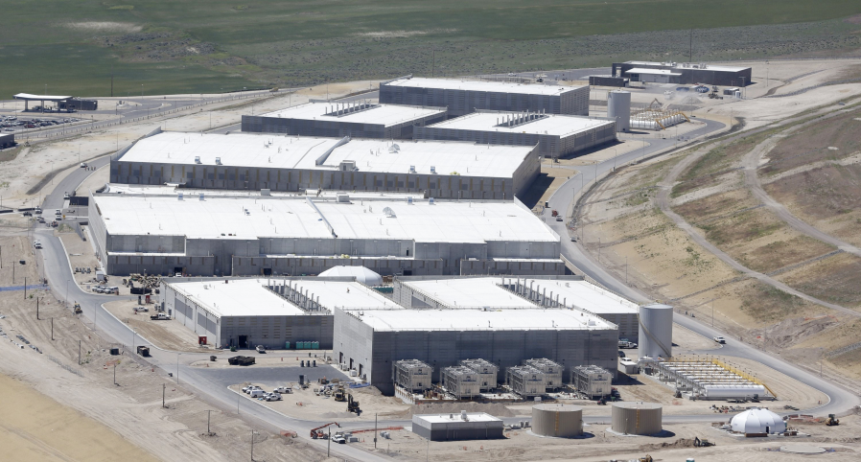
Big Data: Data Centers

Slide 9
Big Data: Under the hood (example)
Time for processing 1 Petabyte of data with a PC?
1 PB = 10¹⁵ B = 1 million Gigabytes = 1 thousand Terabytes
18 hours to read 1 TB at rate of 15MB/S (15*60*60*18 = 972,000 MB ~ 1 TB)
750 days to read 1 PB
Solution: use multiple PCs in parallel!
Time and Cost of processing 1 PB with 1,000 PCs (nodes)?
18 hours!
1,000 * 18 * 0.34$ = 6,120$ for single read!

Slide 10
Big Data – Problem Partitioning
Given k=1,000 computers, each with 64GB memory and 1TB hard disk
How to minimize the execution time of a data science task on data set D = {(x_{i},y_{i}), i = 1…N}
Scenario 1: D is less than 1TB, find the maximum element of D
Solution 1: do everything on a single computer
Cost 1: time to read 1TB to memory and memorize the maximum element so far = 18 hours
Solution 2: Partition D into 1,000 computers, find maximum at each computer, send the 1,000 maximums to one of the computers (master computer) and find their maximum
Cost 2: time to read read 1TB/1,000 = 1GB to memory = 1 minute, plus small cost of merging the 1,000 maximums

Slide 11
Big Data – Problem Partitioning
Given k=1,000 computers, each with 64GB memory and 1TB hard disk
Scenario 1: D is less than 1TB, find the maximum element of D
Solution 3: Partition D into 1,000 computers and keep each 1GB chunk in memory
Cost 3: time to read 1TB/1,000 = 1GB from memory = 1 second, plus small cost of merging at the master computer
Scenario 2: D is larger than 1TB, find the maximum element of D
Solution 2 from Scenario 1 is the only viable one
Question: How to partition?
Sort the rows and columns first, based on some criterion
Shuffle the data first
Split by rows, columns, or blocks

Slide 12
Big Data – Problem Partitioning
Examples of data science tasks
Find average of the 57th attribute
Find 10th largest value in the 57th attribute
Find median of the 57th attribute
Plot a histogram of the 57th attribute
Classify new example using k-nearest neighbor
Perform k-means clustering
Perform hierarchical clustering
Train a neural network

